Slide 1
RESULTS
FILTER-BASED METHODS

Slide 2
Intensity
(16 bit tiff)
Dimensionality Reduction
(UMAP)
Classification
(XGBoost Classifier)
Temperature Distribution (32 bit tiff radiometric)

Slide 3
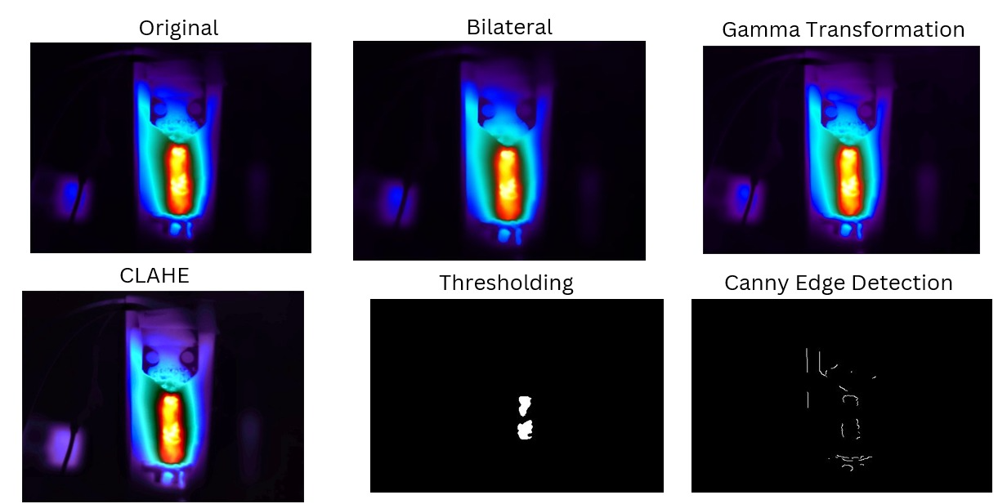
STAGE 1

Slide 4
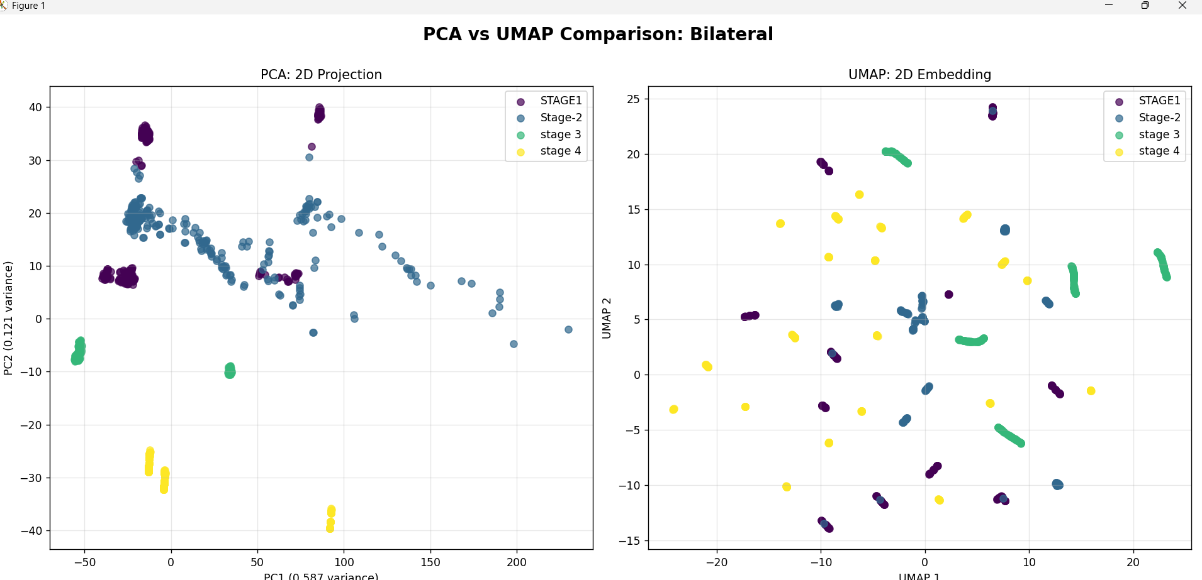
2D PROJECTION(PCA VS UMAP)
BILATERAL

Slide 5
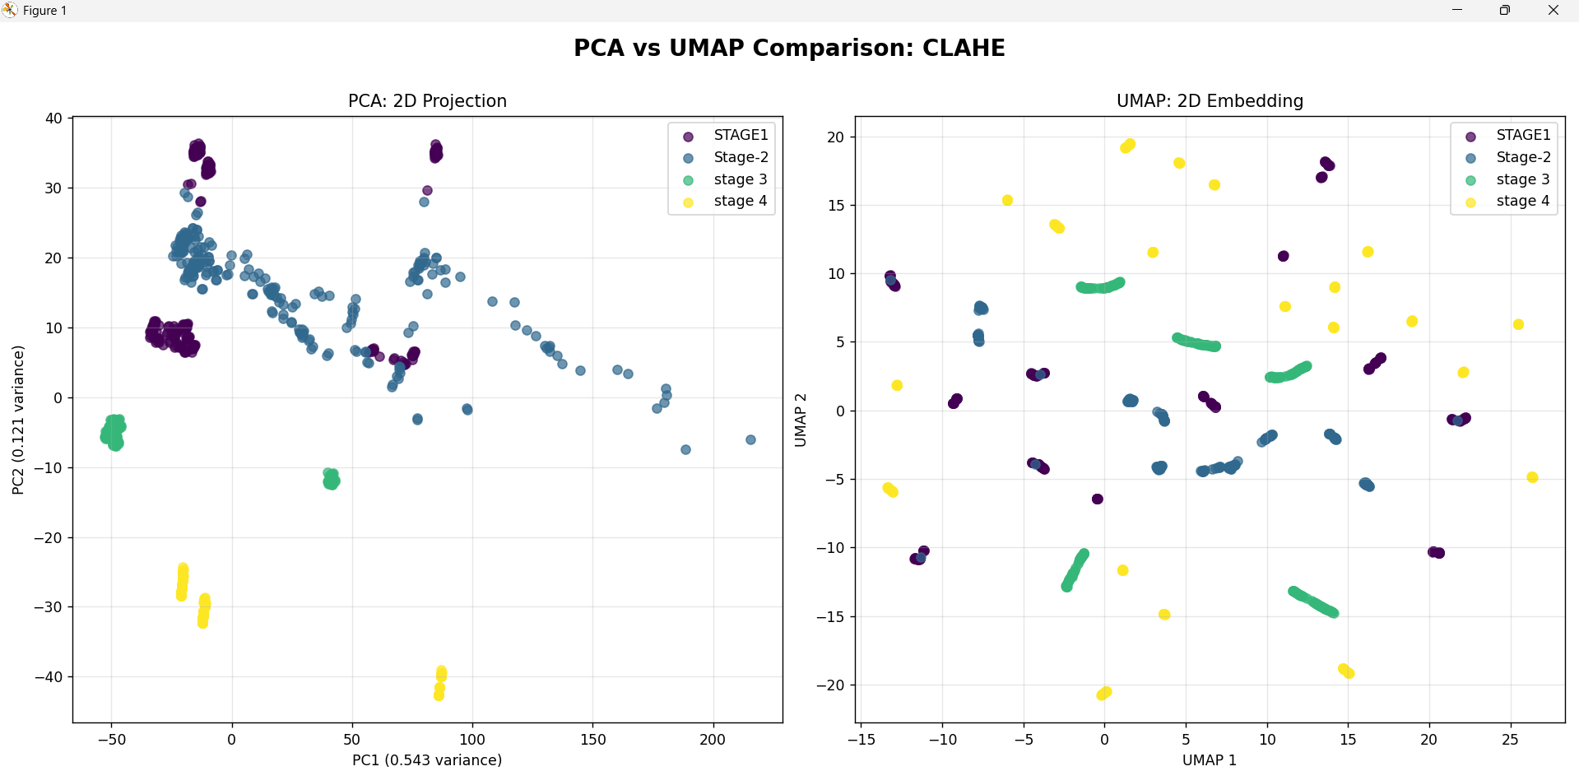
CLAHE

Slide 6
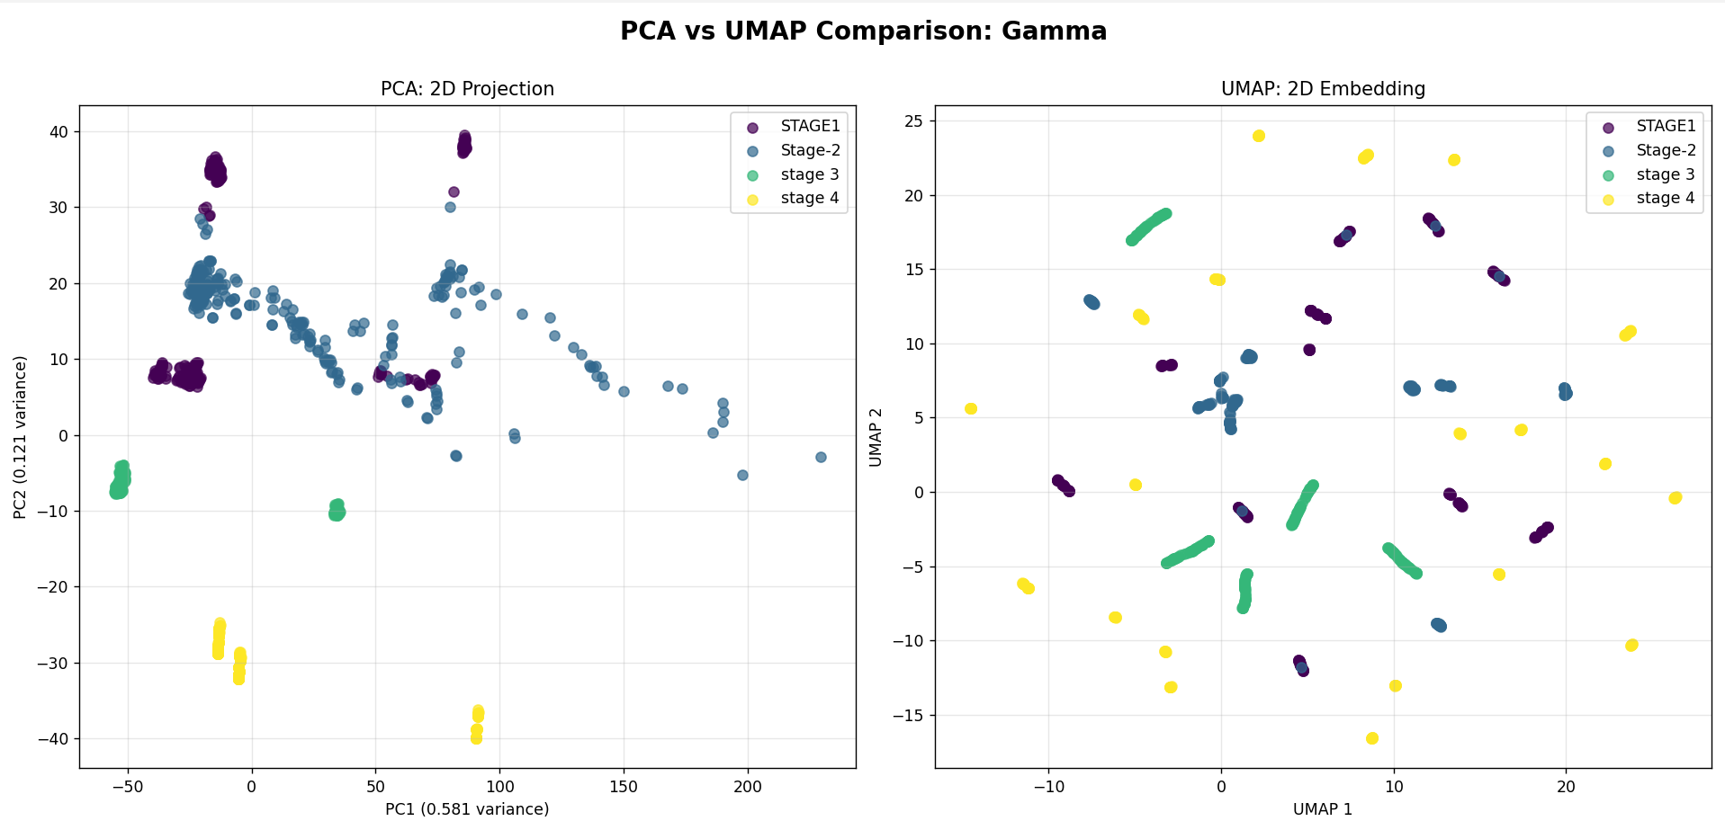
GAMMA TRANSFORMATION

Slide 7
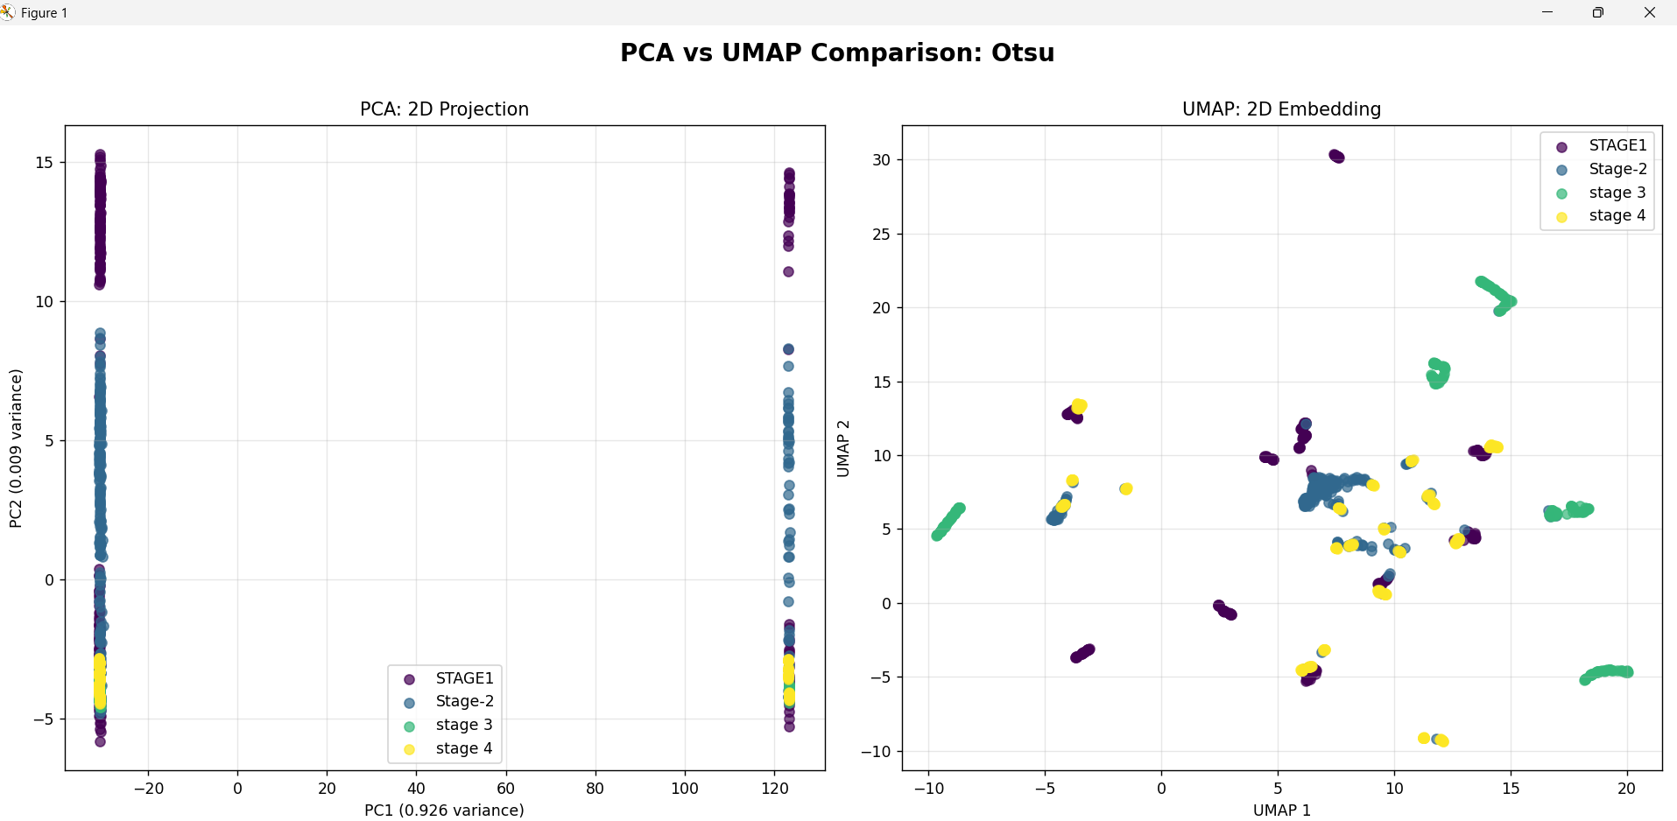
THRESHOLDING

Slide 8
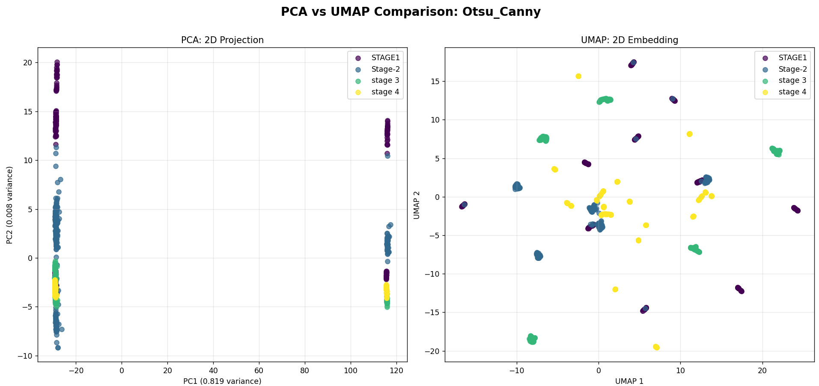
CANNY EDGE DETECTION

Slide 9
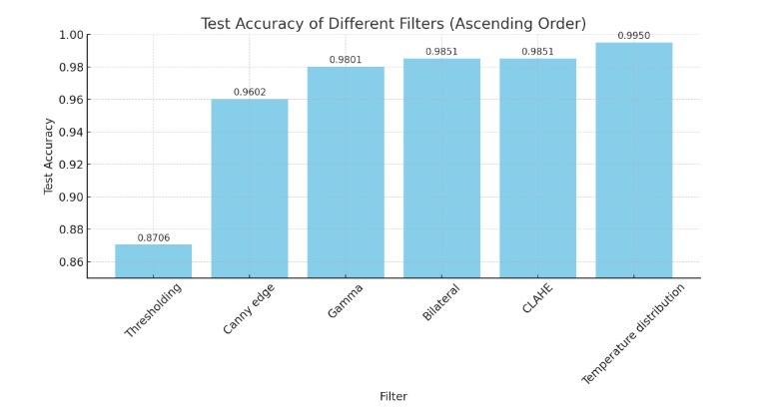
Filter: CLAHE
Test Accuracy: 0.9851
Cross-validation: 0.9920 (+/- 0.0080)
CV Scores: ['0.9900', '0.9950', '0.9950', '0.9851', '0.9950']
Classification Report:
precision recall f1-score support
STAGE1(27-120) 0.94 1.00 0.97 51
Stage-2(27-120) 1.00 0.94 0.97 50
stage 3(27-660) 1.00 1.00 1.00 50
stage 4(150-1600) 1.00 1.00 1.00 50
accuracy 0.99 201
macro avg 0.99 0.98 0.99 201
weighted avg 0.99 0.99 0.99 201
Filter: Gamma
Test Accuracy: 0.9801
Cross-validation: 0.9920 (+/- 0.0101)
CV Scores: ['0.9851', '1.0000', '0.9900', '0.9900', '0.9950']
Classification Report:
precision recall f1-score support
STAGE1(27-120) 0.94 0.98 0.96 51
Stage-2(27-120) 1.00 0.94 0.97 50
stage 3(27-660) 1.00 1.00 1.00 50
stage 4(150-1600) 0.98 1.00 0.99 50
accuracy 0.98 201
macro avg 0.98 0.98 0.98 201
weighted avg 0.98 0.98 0.98 201
Filter: Canny edge
Test Accuracy: 0.9602
Cross-validation: 0.9701 (+/- 0.0308)
CV Scores: ['0.9403', '0.9801', '0.9801', '0.9801', '0.9701']
Classification Report:
precision recall f1-score support
STAGE1(27-120) 0.93 1.00 0.96 51
Stage-2(27-120) 0.96 0.90 0.93 50
stage 3(27-660) 1.00 1.00 1.00 50
stage 4(150-1600) 0.96 0.94 0.95 50
accuracy 0.96 201
macro avg 0.96 0.96 0.96 201
weighted avg 0.96 0.96 0.96 201
Filter: Thresholding
Test Accuracy: 0.8706
Cross-validation: 0.8746 (+/- 0.0493)
CV Scores: ['0.8408', '0.8856', '0.8507', '0.9055', '0.8905']
Classification Report:
precision recall f1-score support
STAGE1(27-120) 0.98 0.90 0.94 51
Stage-2(27-120) 0.97 0.60 0.74 50
stage 3(27-660) 0.96 1.00 0.98 50
stage 4(150-1600) 0.69 0.98 0.81 50
accuracy 0.87 201
macro avg 0.90 0.87 0.87 201
weighted avg 0.90 0.87 0.87 201
Filter: Bilateral
Test Accuracy: 0.9851
Cross-validation: 0.9871 (+/- 0.0185)
CV Scores: ['0.9851', '0.9701', '0.9950', '0.9900', '0.9950']
Classification Report:
precision recall f1-score support
STAGE1(27-120) 0.94 1.00 0.97 51
Stage-2(27-120) 1.00 0.94 0.97 50
stage 3(27-660) 1.00 1.00 1.00 50
stage 4(150-1600) 1.00 1.00 1.00 50
accuracy 0.99 201
macro avg 0.99 0.98 0.99 201
weighted avg 0.99 0.99 0.99 201
Temperature distribution
Test Accuracy: 0.9950
Cross-validation Mean: 0.9960
Cross-validation Std: 0.0049
Cross-validation 95% CI: 0.9960 ± 0.0098
Individual CV Scores: ['1.0000', '1.0000', '0.9880', '0.9960']
Classification Report:
precision recall f1-score support
STAGE1_32 1.00 0.98 0.99 50
STAGE2_32 0.98 1.00 0.99 50
STAGE3_32 1.00 1.00 1.00 50
STAGE4_32 1.00 1.00 1.00 50
accuracy 0.99 200
macro avg 1.00 0.99 0.99 200
weighted avg 1.00 0.99 0.99 200

